Slide 1
Hydrogeologic Frameworks Analytical Water Budgets

Slide 2
Groundwater Flow Modeling Process
Define Problem and Objectives
Conceptual Model
Mathematical Model
Model Calibration and Assessment
Apply Model
Revise Objectives ?

Slide 3
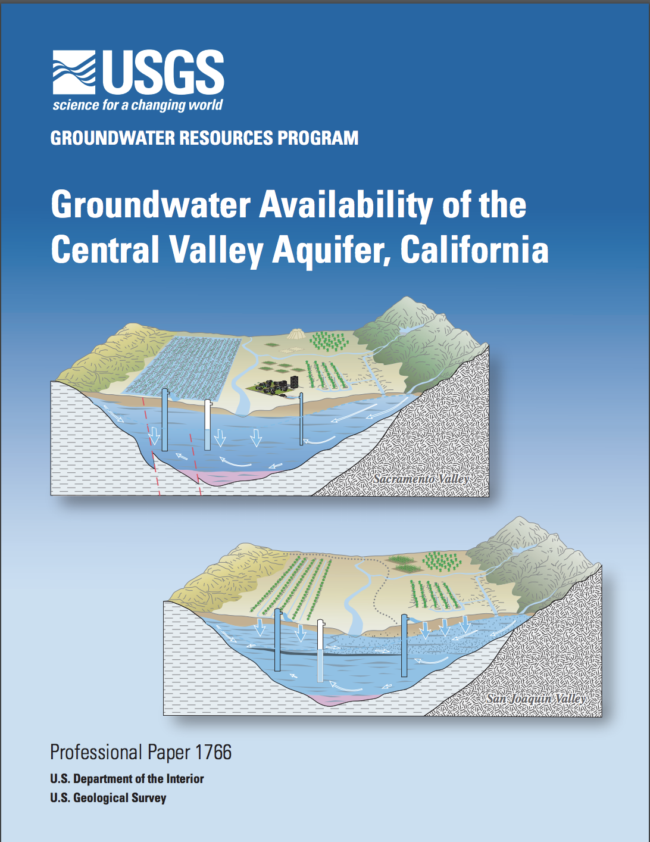
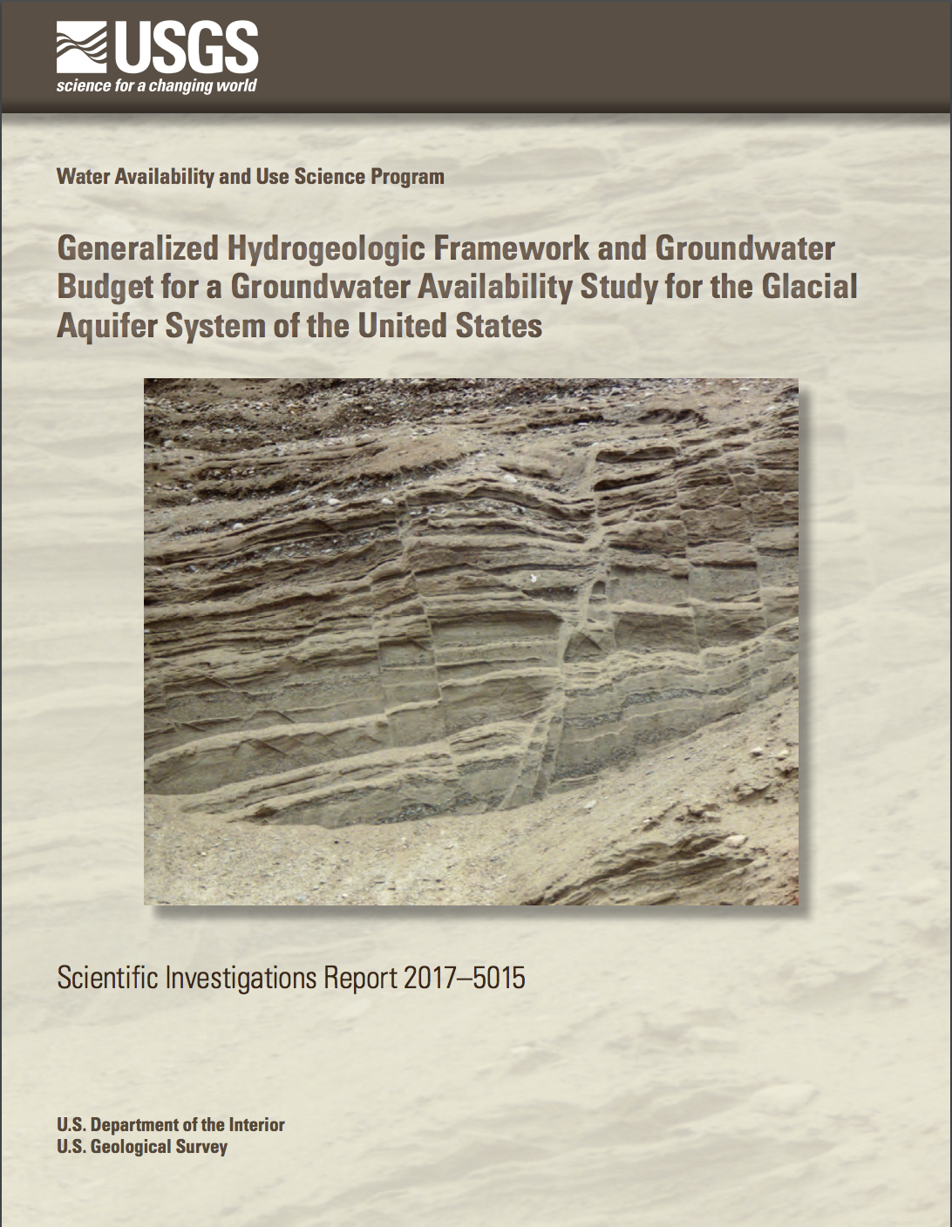
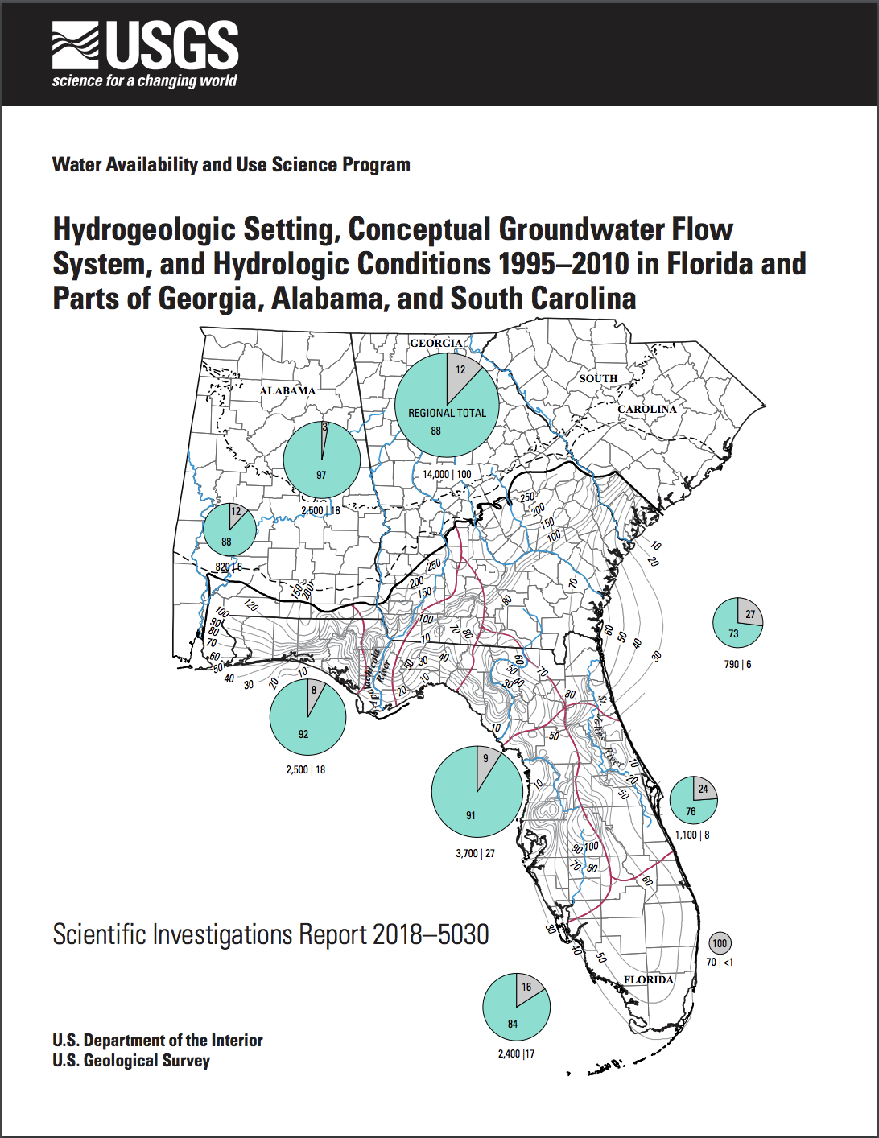
Hydrogeologic Frameworks and Water Budgets

Slide 4
Hydrogeologic Frameworks
The groundwater model framework consists of the hydrostratigraphy, structural features, and hydraulic properties of the groundwater system.
The hydrostratigraphy of a groundwater system is developed through the compilation of geophysical, lithologic, and driller logs.
Logs can then be used to interpret the depth of each hydrogeologic unit (aquifer or confining unit).

Slide 5
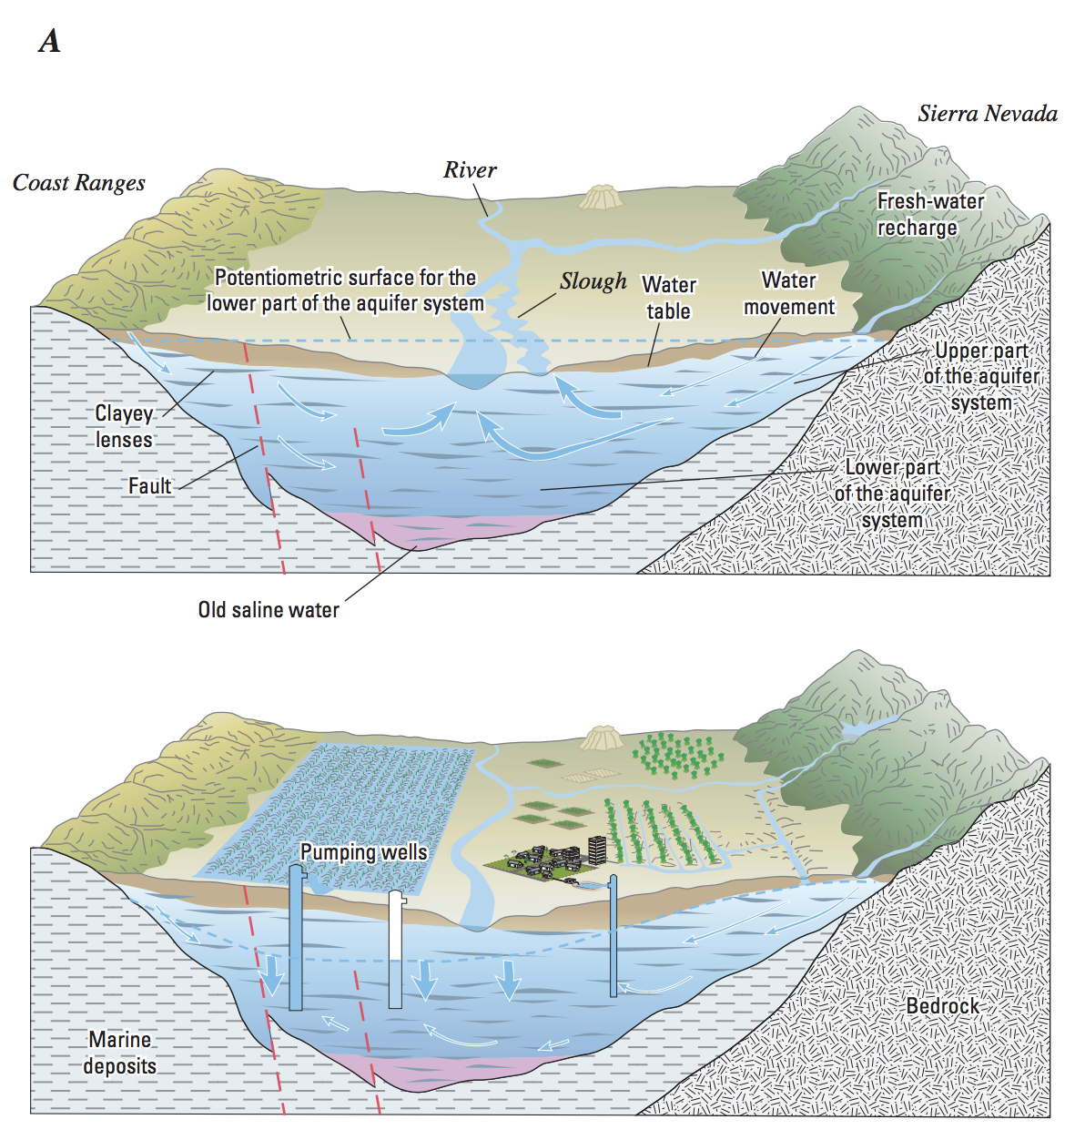
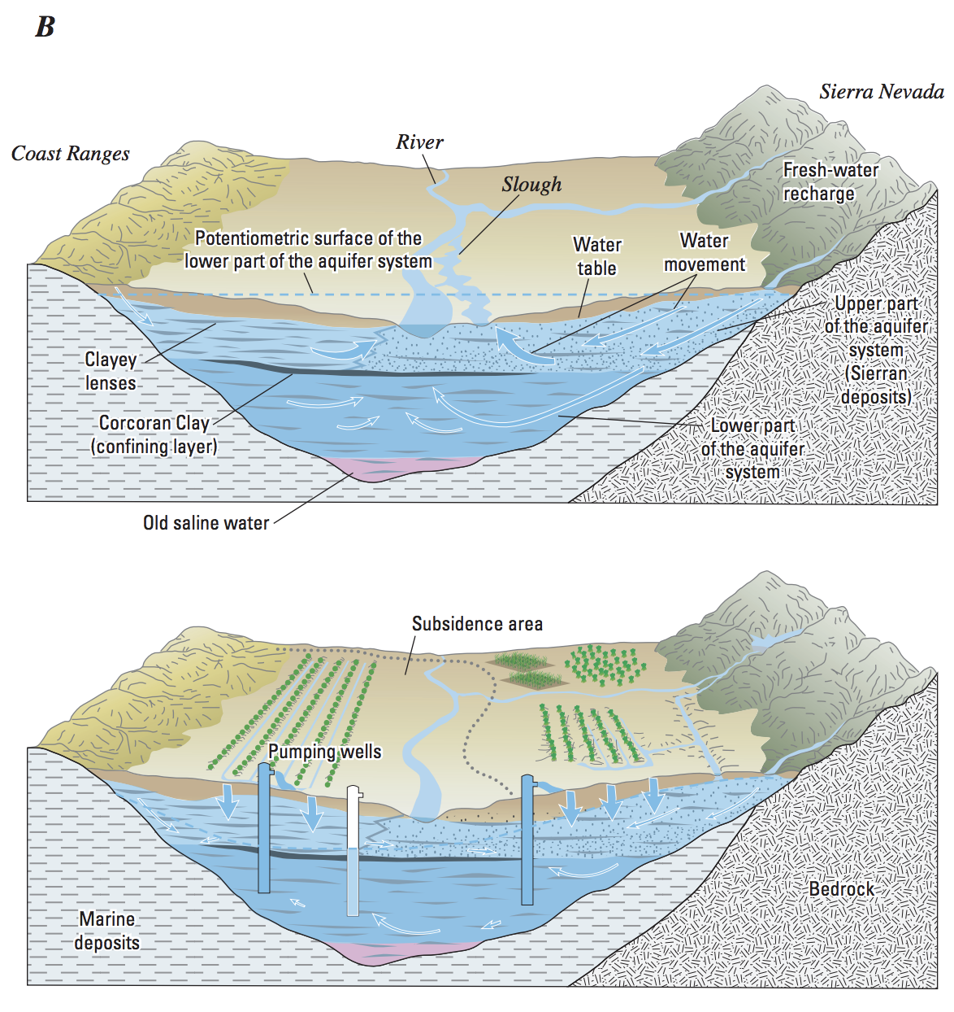
Hydrogeologic Frameworks

Slide 6
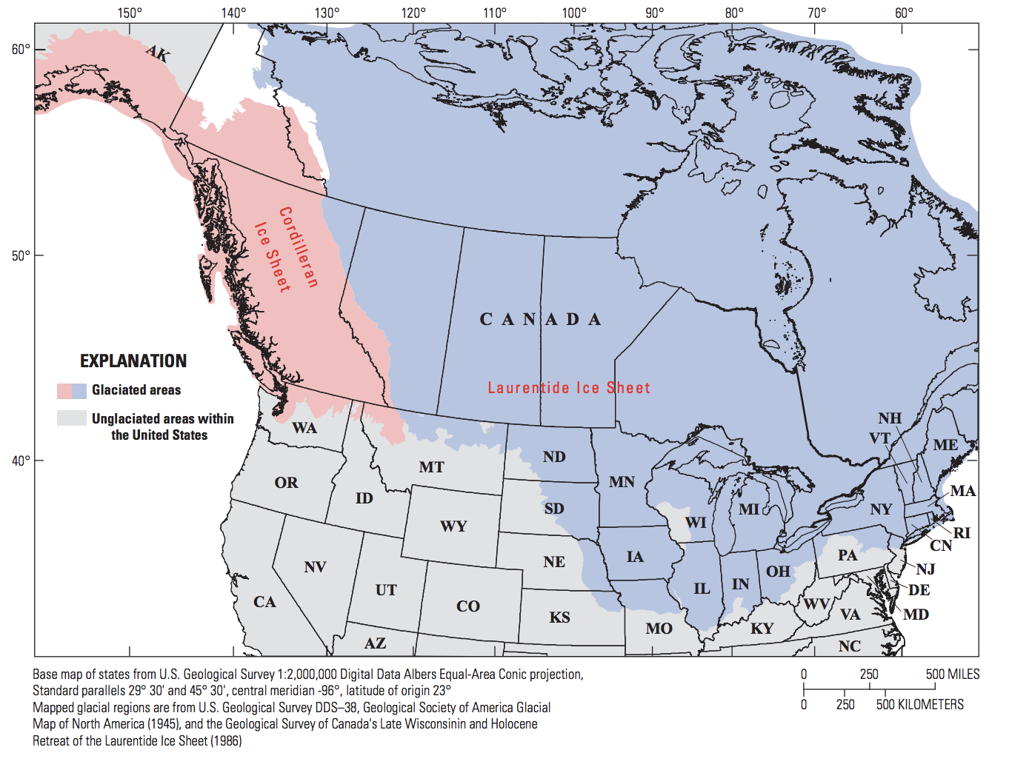
Hydrogeologic Frameworks

Slide 7
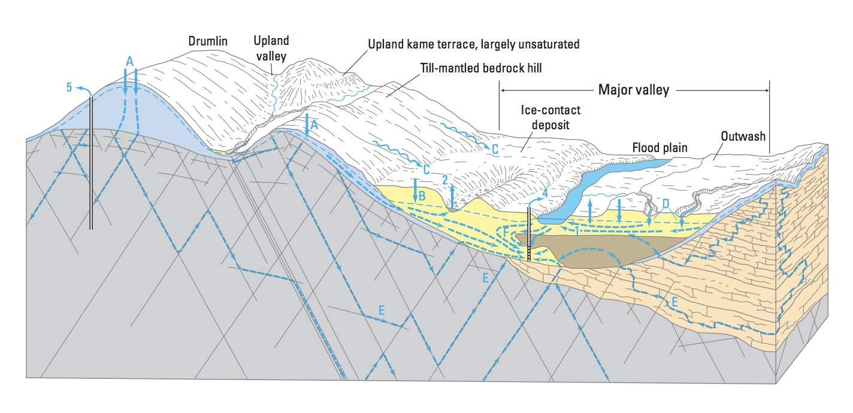
Hydrogeologic Frameworks

Slide 8
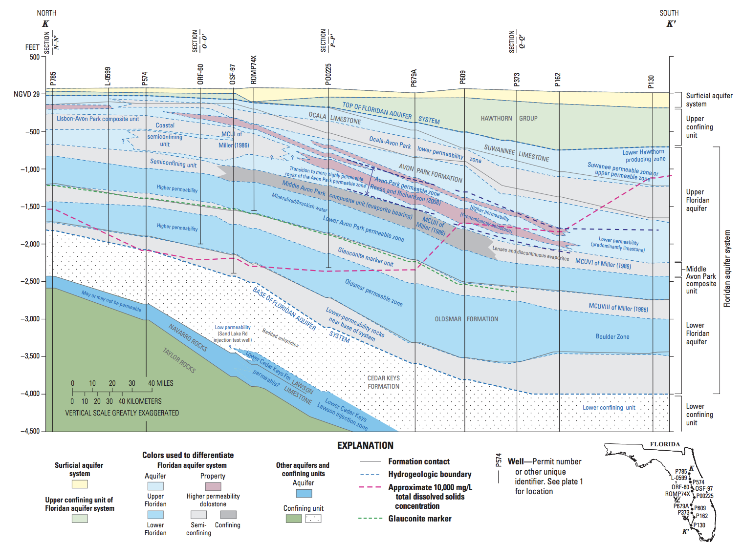
Hydrogeologic Frameworks

Slide 9
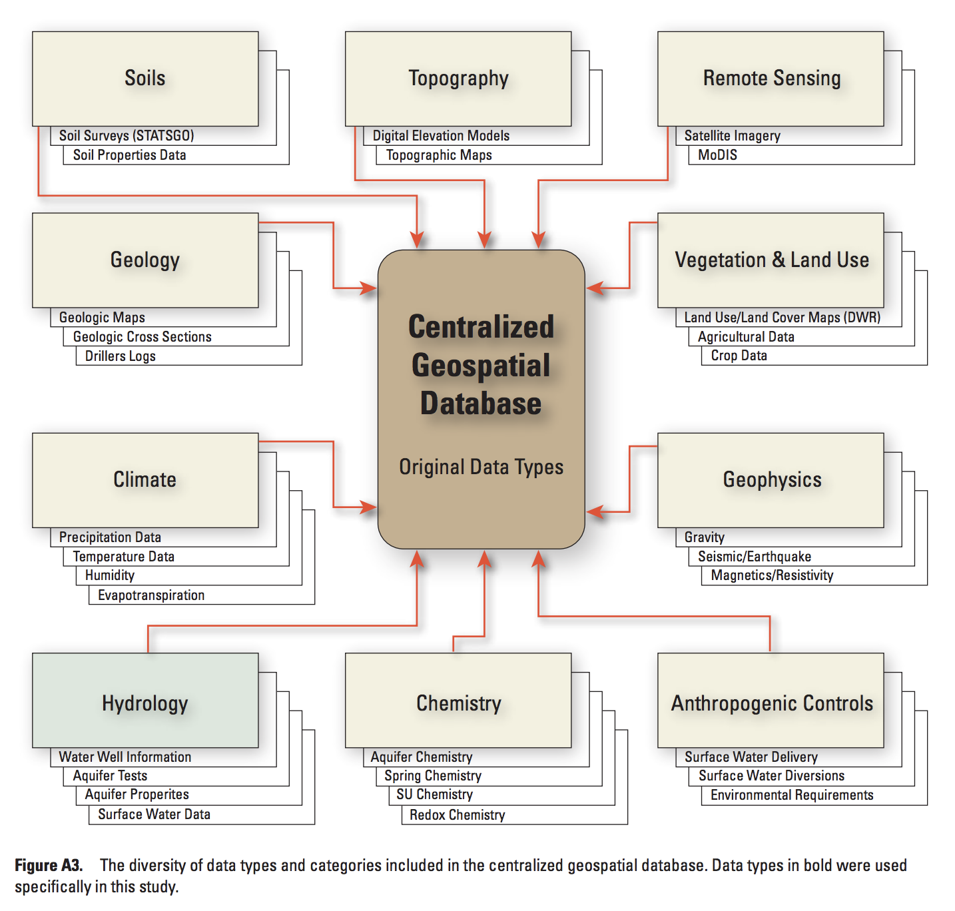
Hydrogeologic Frameworks

Slide 10
Water Budgets
Water budgets account for the inputs, outputs, and changes in the amount of water by breaking the water cycle down into components
Basic components of water budgets are precipitation, evapotranspiration, surface-water and groundwater flow into and out of the watershed, change in surface-water and groundwater storage, change in snow and ice storage, human withdrawals, and interbasin transfers

Slide 11
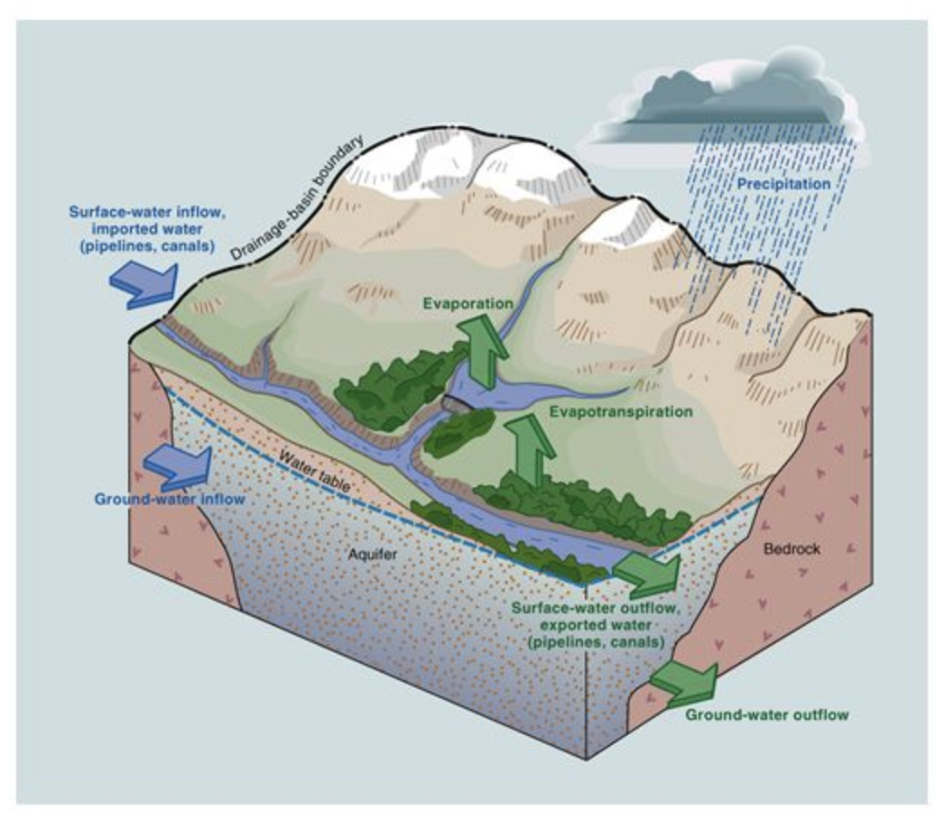
Water Budgets

Slide 12
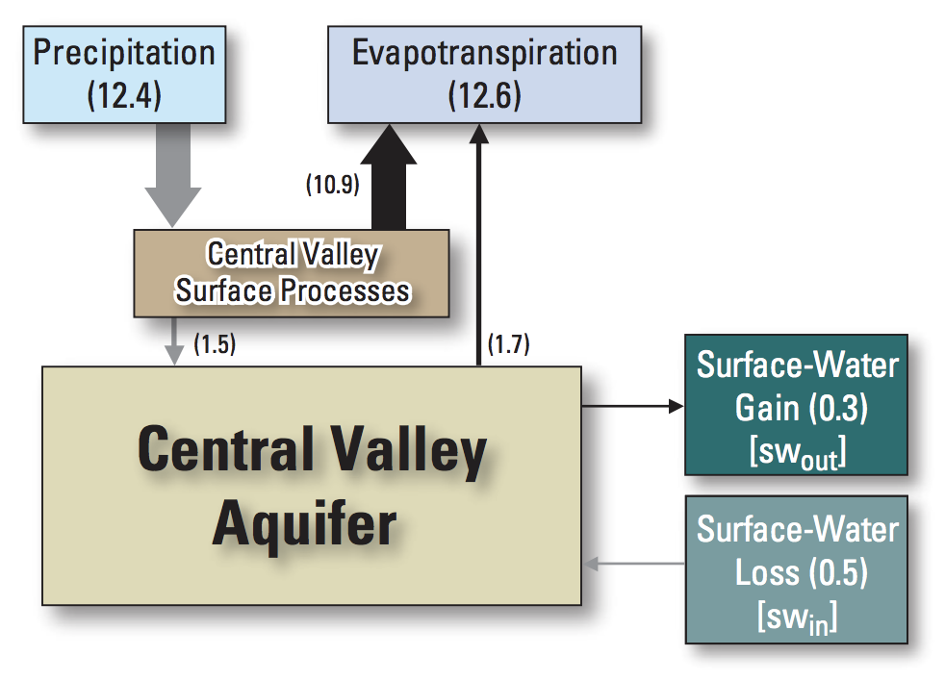
Water Budgets

Slide 13
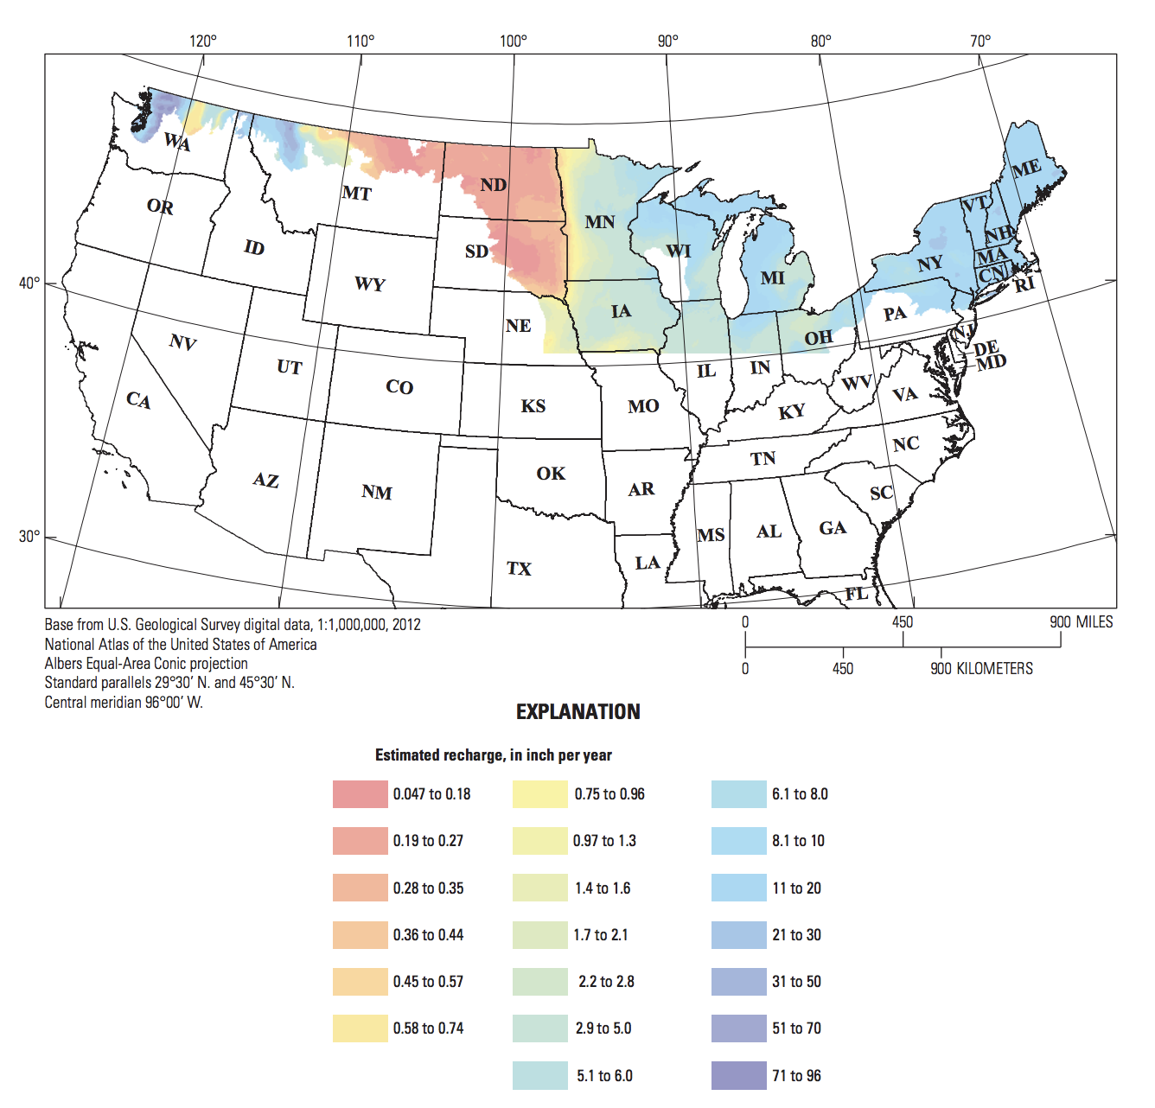
Water Budgets

Slide 14
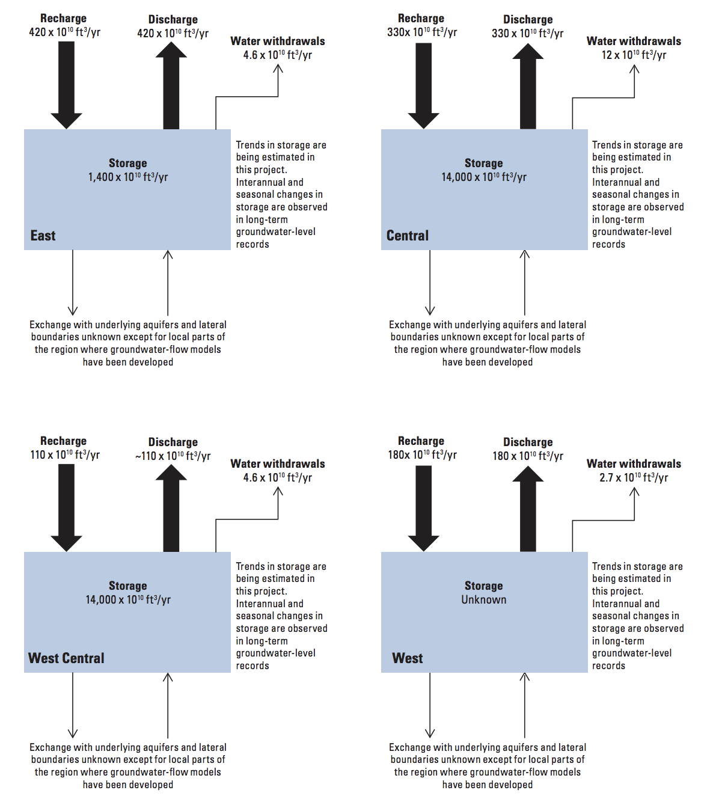
Water Budgets

Slide 15
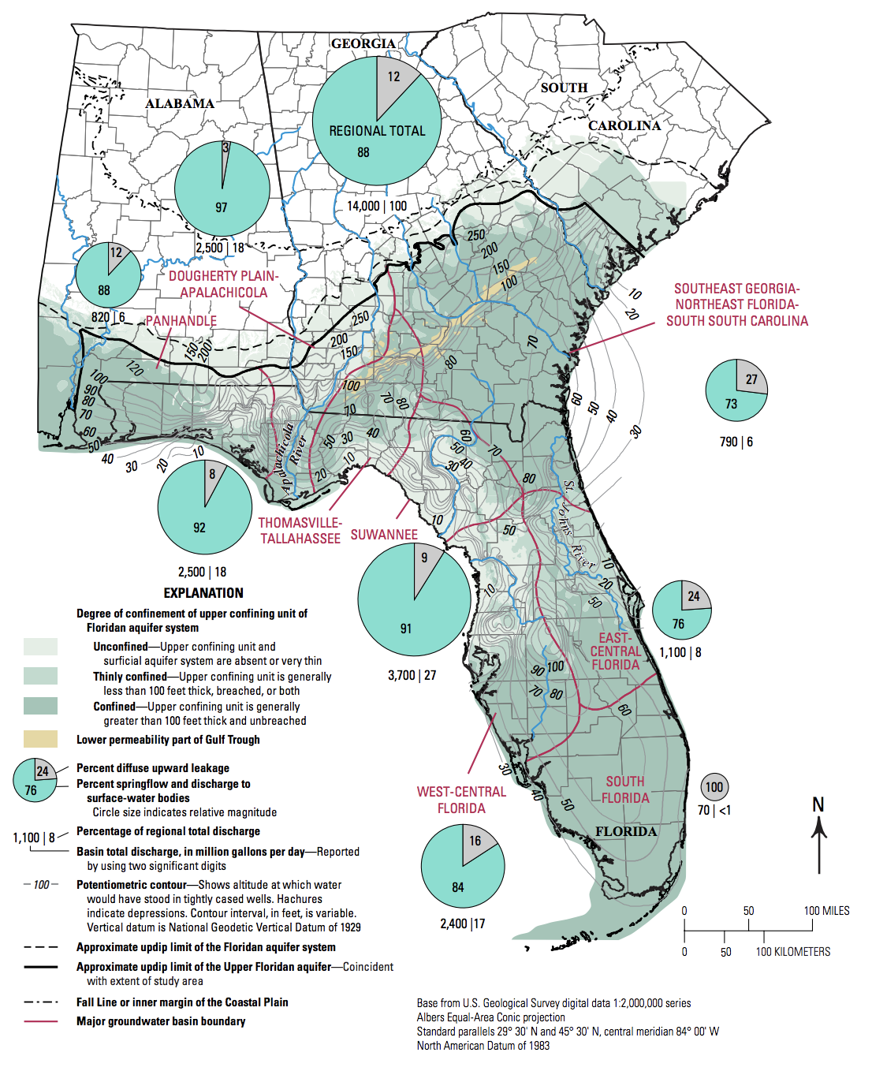
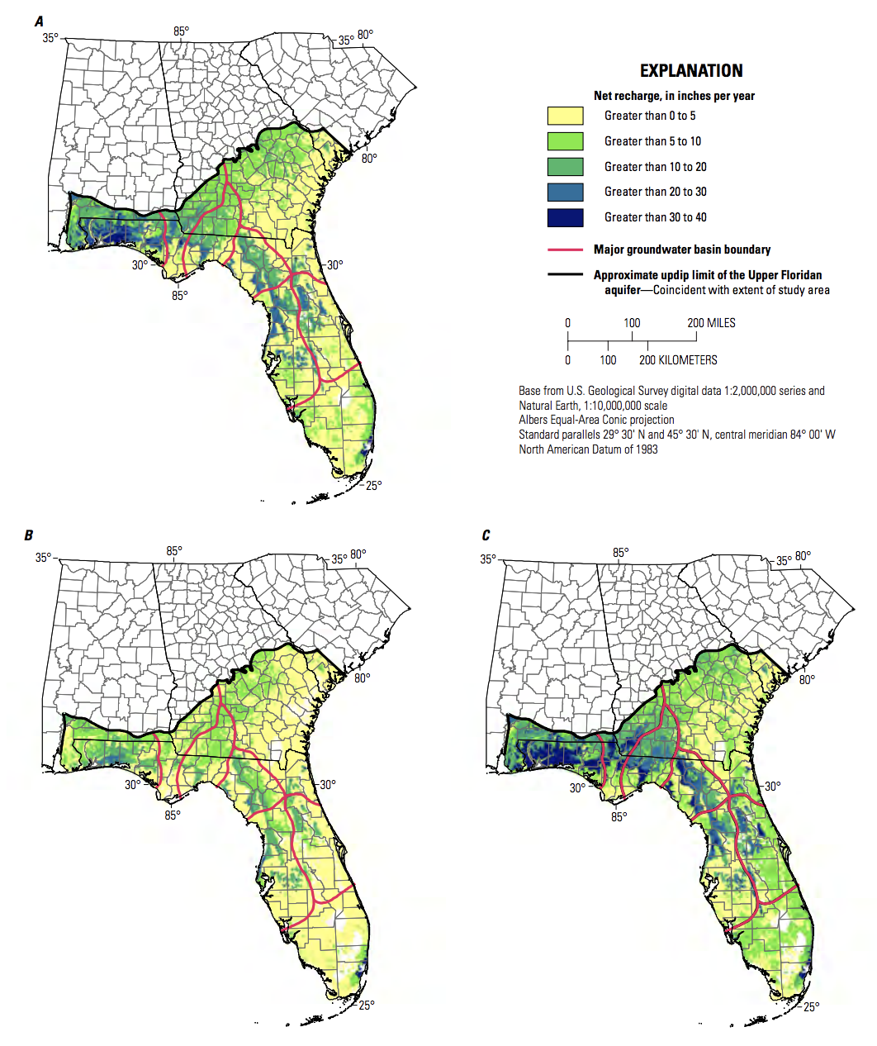
Water Budgets

Slide 16
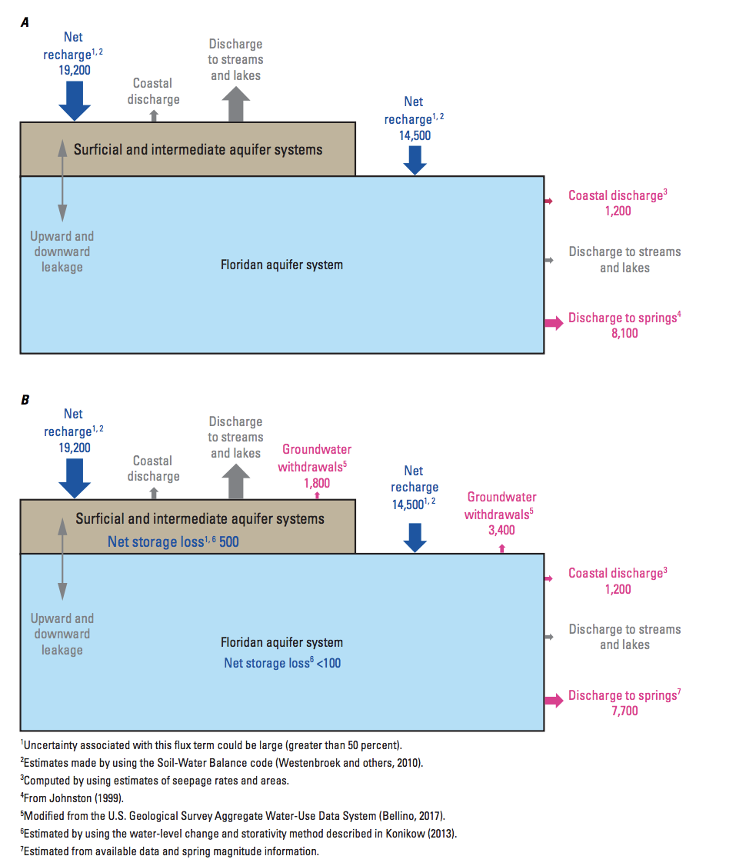
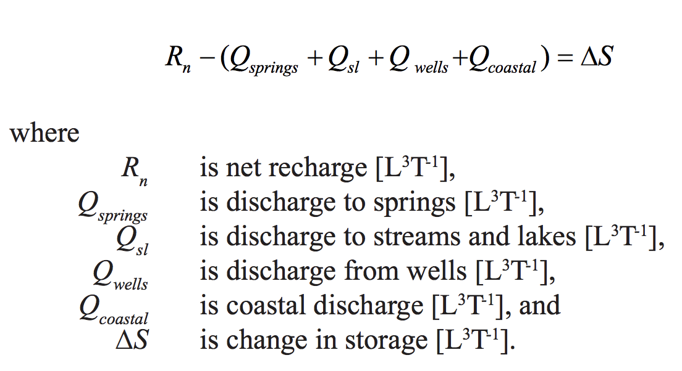
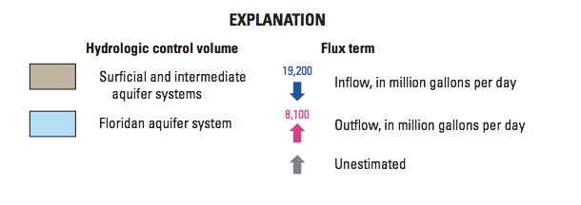
Water Budgets

Slide 17

Questions

